Slide 1
BittiGidiyor
Altuğ Aktepe
Asiye Nur Özcan
Ayşe Aysu Cengiz
Furkan Yıldız
Hüseyin Kaya

Slide 2
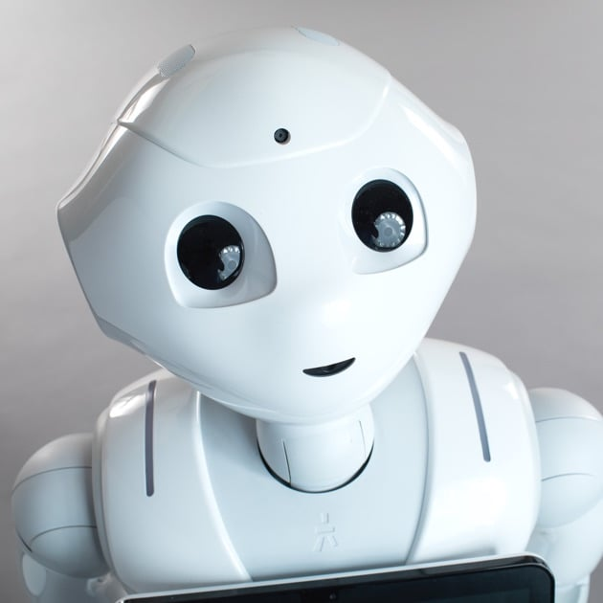
Pepper Robot

Slide 3
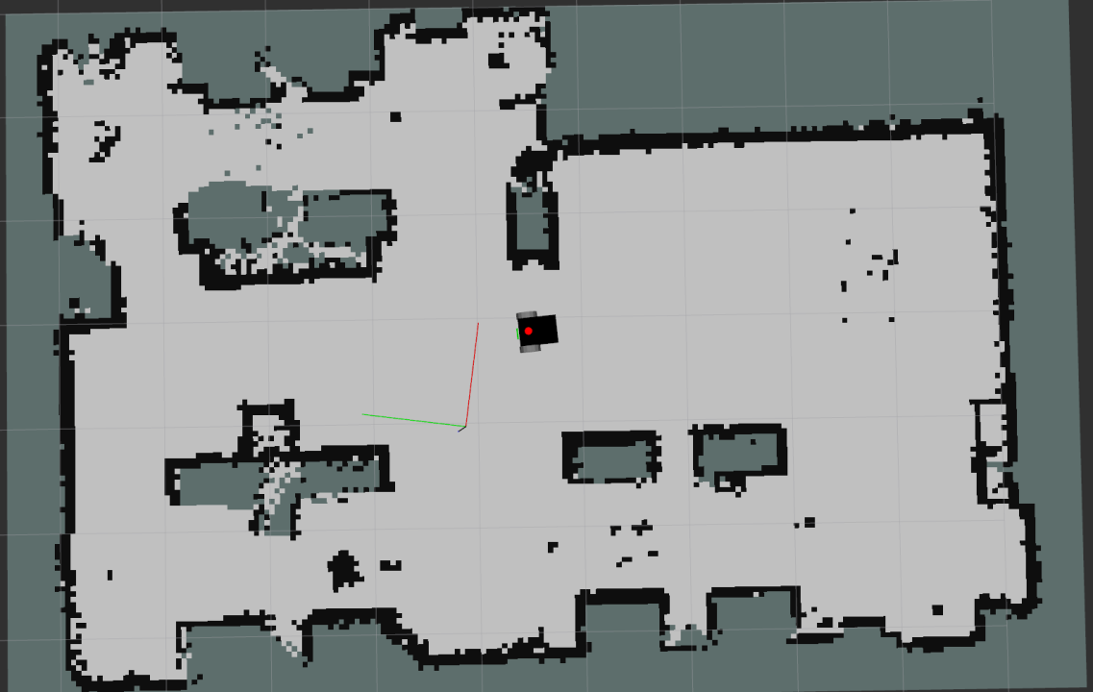
1. SLAM (Simultaneous Localization and Mapping)
Creating a map of ROMER
Localizing the robot
Sensors:
Camera
Sonar
IMU

Slide 4
2. Autonomous Navigation
Offline path planning
Map created
Before execution
Online path planning
Real time, during execution
Robust to dynamic obstacles

Slide 5
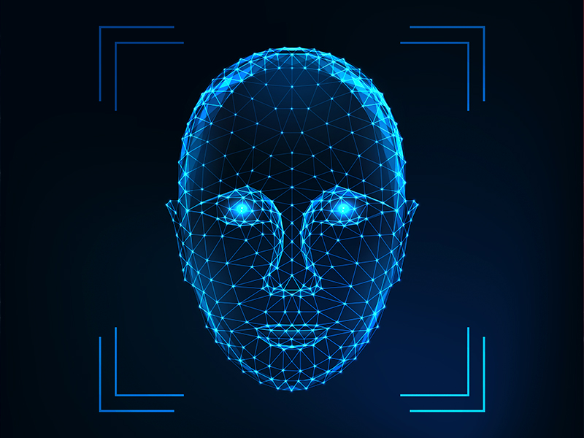
3. Face Recognition
Differentiating known and new people
OpenCV or AI models
Allowing people to choose a room to go, or a person to meet via touch screen

Slide 6
4. Human interaction
Showing the path to the destination on tablet
Granting small requests
Forming dialogue

Slide 7

5. Charging Mode
Limited battery
Autonomous navigation to charging station when,
Below a battery threshold
After a time at night
One person is left inside the building

Slide 8
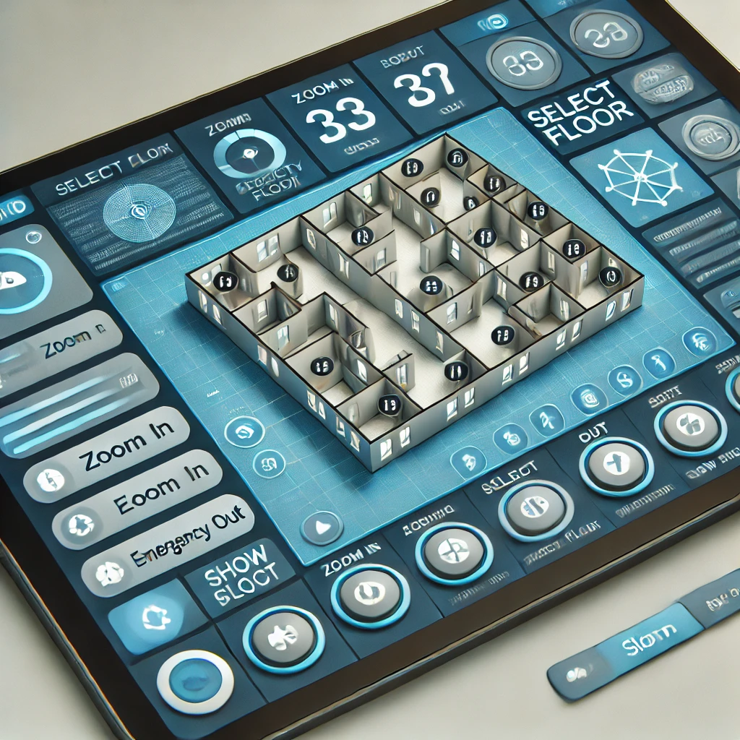
6. GUI
Location and status of the robot
Calling for help
Autonomous navigation command
Manual control

Slide 9
7. ROS2 Communication
Using ros1_bridge
GUI communication
Communication with other robots

Slide 10
7. Extras
Understanding sign language
Connecting to cameras and show live images on screen
Using the elevator
Turning off extra lights (wireless or by hand)

Slide 11
Dictionary of grippers
Existing products and how they can be modified

Slide 12
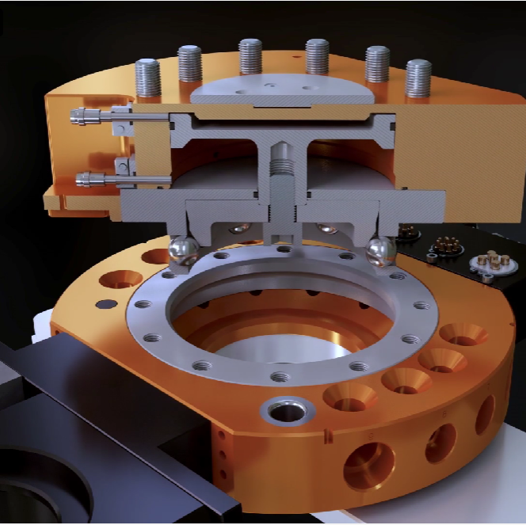
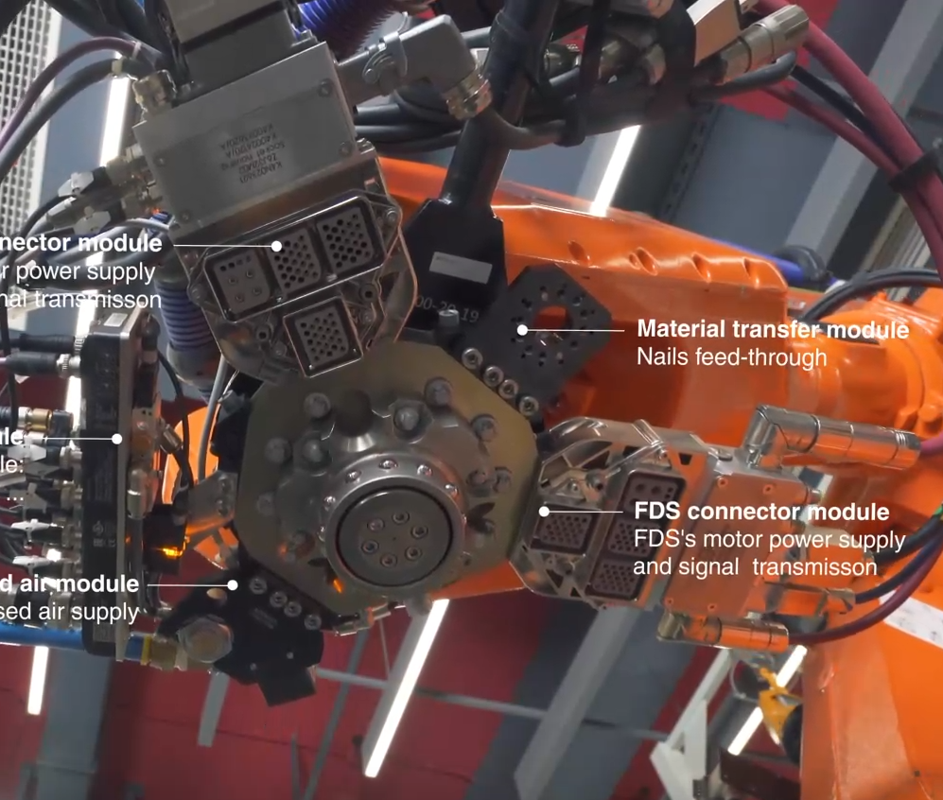
Existing Gripper (or Tool) Changers
Pneumatic
Uses many connectors to work with robot arm

Slide 13
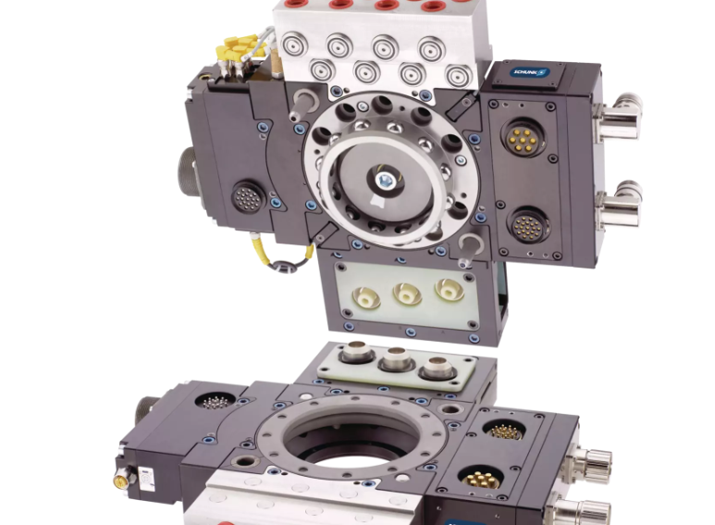
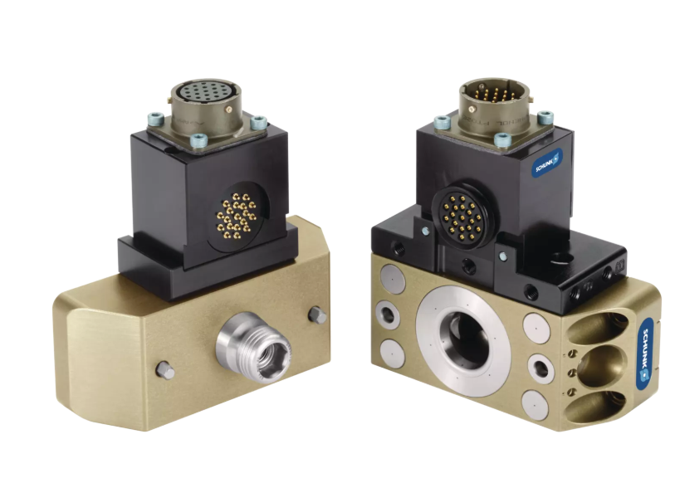
Similar approaches

Slide 14
What can we do?

Slide 15
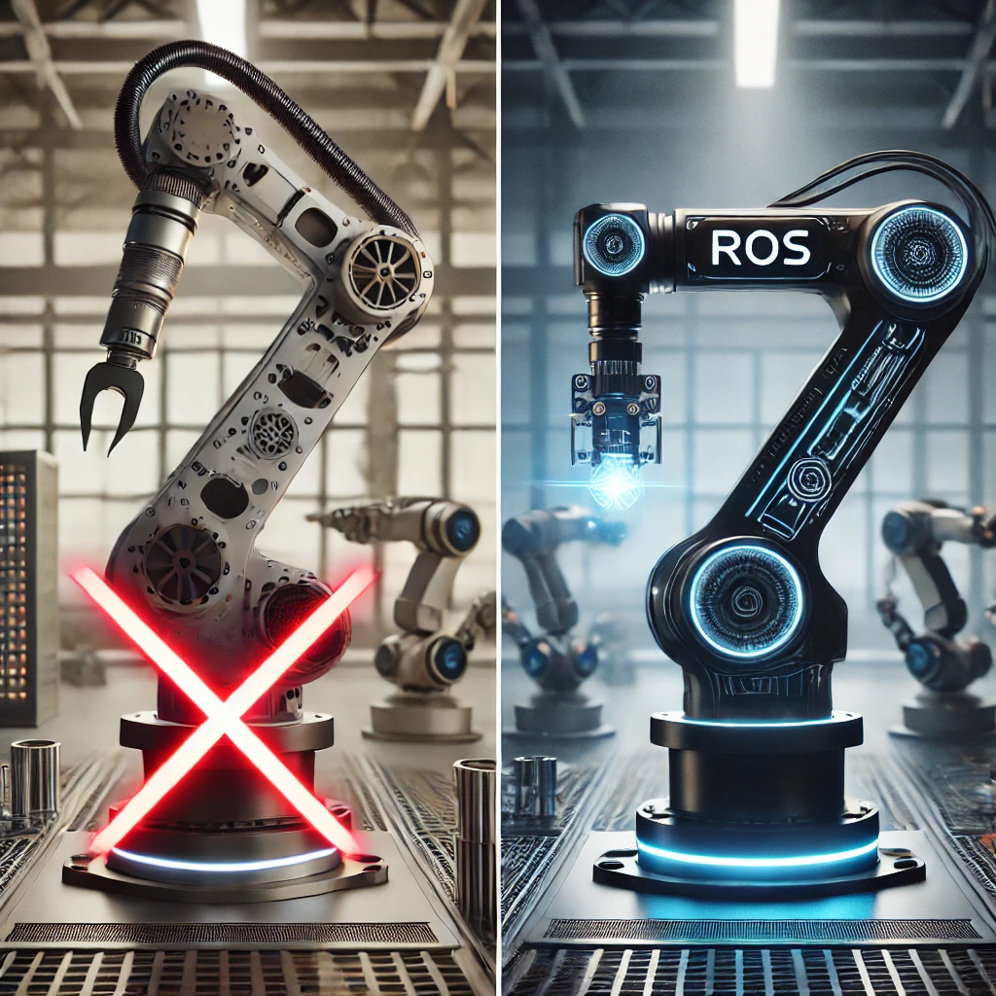
1.Connectors can be eliminated

Slide 16
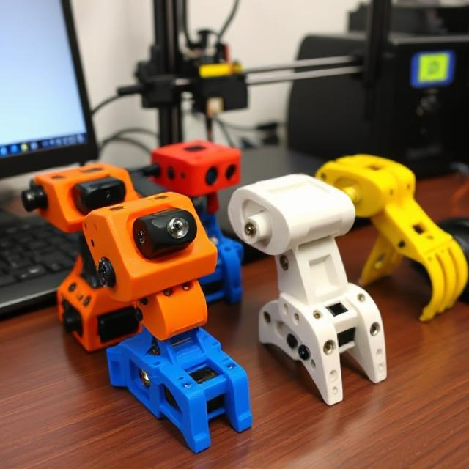
2. Simple 3d printed grippers can be produced with any shape desired

Slide 17
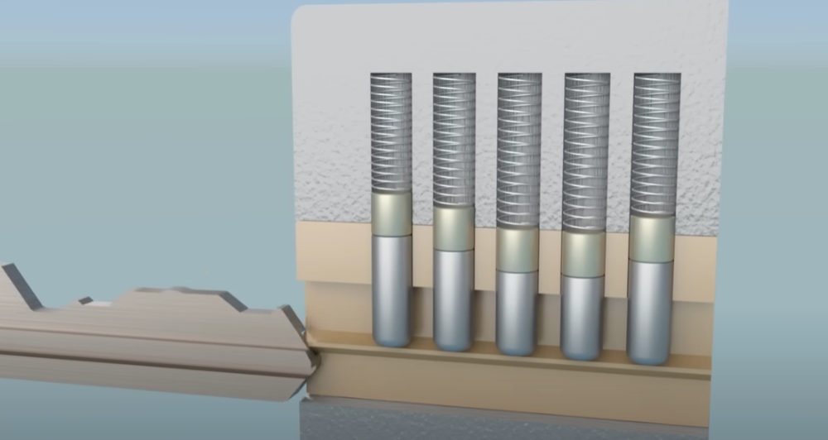
Simpler mechanical locking mechanism design

Slide 18
And many more…

Slide 19

Human Detection and Tracking System at ROMER
bıttıgıdıyor

Slide 20
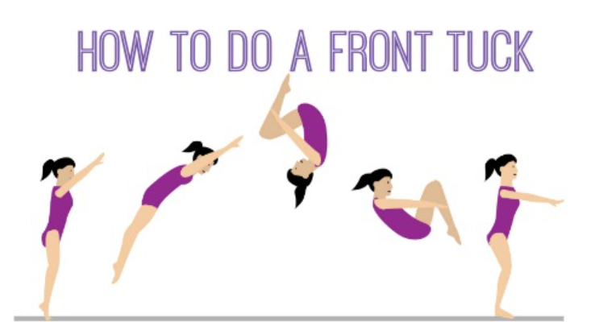
Key Features
•CCTV-Based Monitoring
•Event Monitoring & Alerts: Detects falls, unauthorized access, crowd control violations, and unusual behaviors
•Health Alerts: Simple gymnastic movements for longtime physical inactivity
•Profile-Based Access Control: Individuals must authenticate using predefined access cards or guest profiles.
•Tracking & Statistics: Logs entry/exit times and calculates time spent in different areas (daily, weekly, monthly, yearly, total).
•User-Friendly GUI: live monitoring, alerts, occupancy and admin controls.

Slide 21

GUI Development & Challenges
With PyQt5, the GUI integrates with ROS via rosbridge_server and rqt.
Real-Time Monitoring: Displays live video and crowd alerts
Historical Analytics: Shows occupancy trends and entry/exit logs
Admin Controls: For sensor parameters, security settings and user authentication
Varying Lighting Conditions: Addressed by predefining lighting models for different times of the day

